Slide 1

Ratings prediction
26th Aug,2022
Internship-27
Presented by:
Someshwar Dipak

Slide 2
Acknowledgement
Data Science with ML
SME – Sapna Verma
Flip Robo Technology

Slide 3
Why Ratings Prediction Need:
We have a client who has a website where people write different reviews for technical products.
Now they are adding a new feature to their website i.e. The reviewer will have to add stars(rating) as well with the review.
The rating is out 5 stars and it only has 5 options available 1 star, 2 stars, 3 stars, 4 stars, 5 stars.
Now they want to predict ratings for the reviews which were written in the past and they don’t have a rating.
So, we have to build an application which can predict the rating by seeing the review.

Slide 4
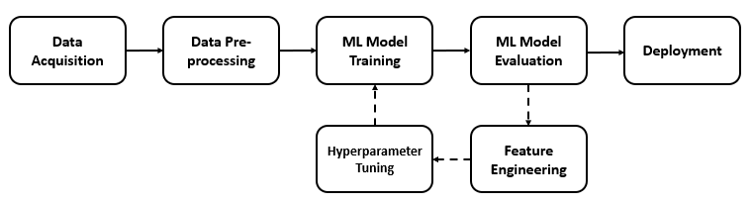
Ratings PREDICTION Diagram:

Slide 5
Visualization of Ratings Prediction

Slide 6
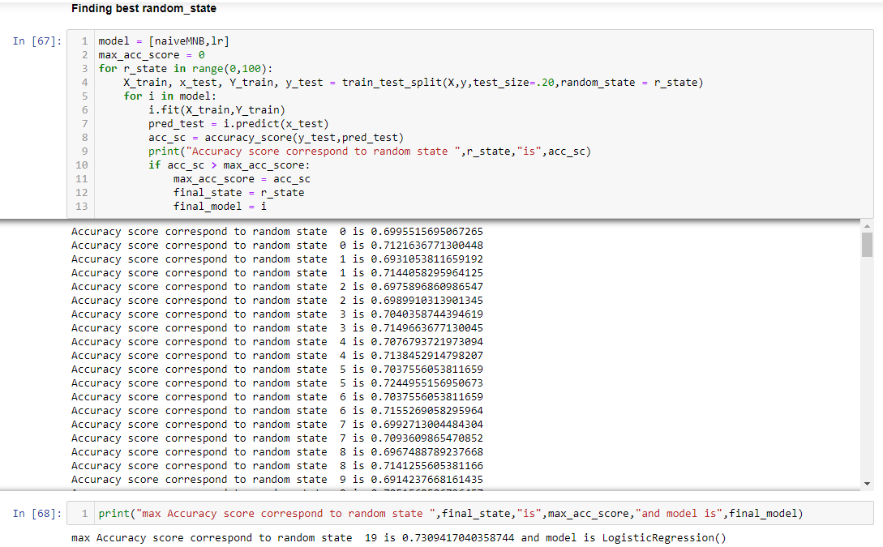
Model Building, Model Evaluation and Selecting the best model

Slide 7
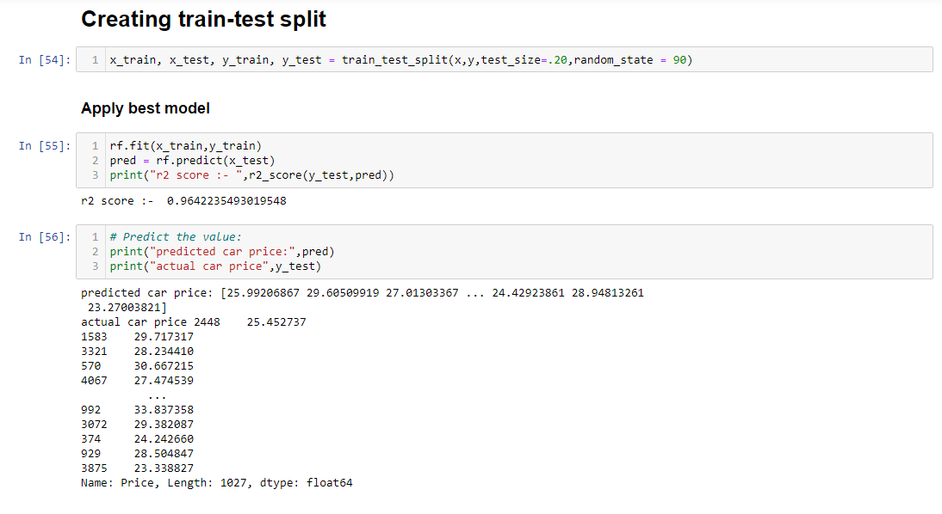
Model Building, Model Evaluation and Selecting the best model

Slide 8
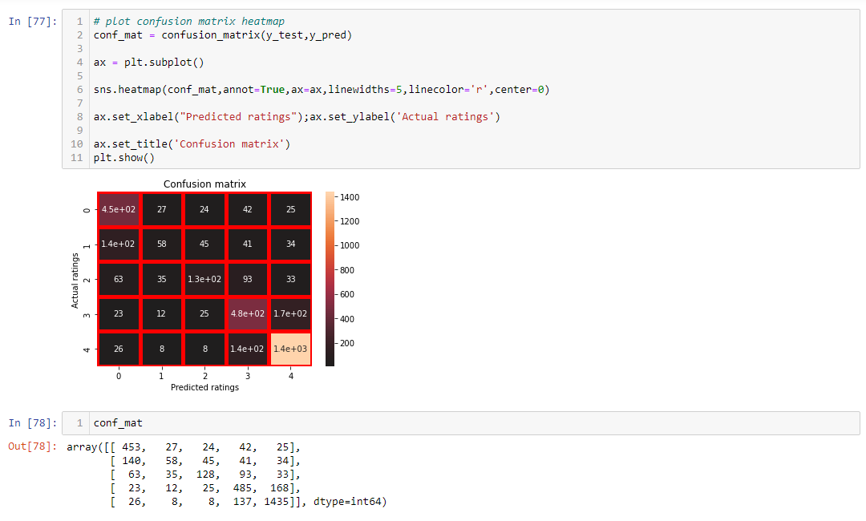
Check Confusion Matrix:

Slide 9
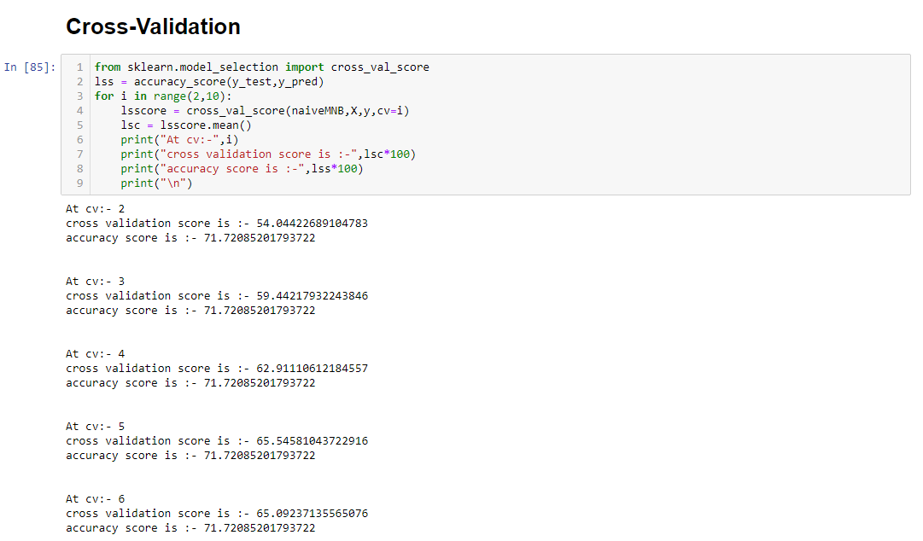
Cross-Validation:

Slide 10
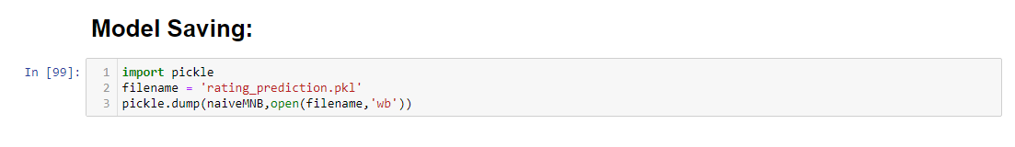
Model Saving:

Slide 11
Conclusion:
This Kernel investigates different models for car price prediction.
Different types of Machine Learning methods including LogisticRegression, and MultinomialNB in machine learning are compared and analysed for optimal solutions.
Even though all of those methods achieved desirable results, different models have their own pros and cons.
The MultinomialNB is probably the best one and has been selected for this problem.
Finally, the MultinomialNB is the best choice when parameterization is the top priority.

